Slide 1

Hot Topics – Summer Edition
Partial retirement

Slide 2

Agenda
Criteria
Where to Start?
CSP15 form
Scheme Administrator actions
NIGO process
WPS Refunds
Abatement
CSP13 form
Further Support
What's coming up?

Slide 3

Partial retirement - Criteria
Must get employer approval
Must be of at least minimum pension age
Must reduce current earnings by at least 20%
Must apply for partial retirement within 3 months of reshaping their job
Notes:
The employer has a say in whether or not the member can go partially retied as they need to agree to the new hours/salary the member is suggesting.
The member must be of at least minimum pension age and the same early retirement reductions would apply.
The majority of members will have a minimum age of 55 but this or 50 for those with service before 06/04/2006
They must reduce their earnings by a minimum of 20%, so the member could actually stay full time if they wish and change to a lower paid job.
They only have 3 months from the day the job reshape started to apply for partial retirement.
The change is meant to be a permanent one.

Slide 4

Partial retirement - Employer Decision
The employer has the choice.
The employer doesn’t not have to agree to the proposed new working pattern if it doesn’t suit the needs of the business.
Notes:
The employer has a say in whether or not the member can go partially retied as they need to agree to the new hours/salary the member is suggesting.

Slide 5
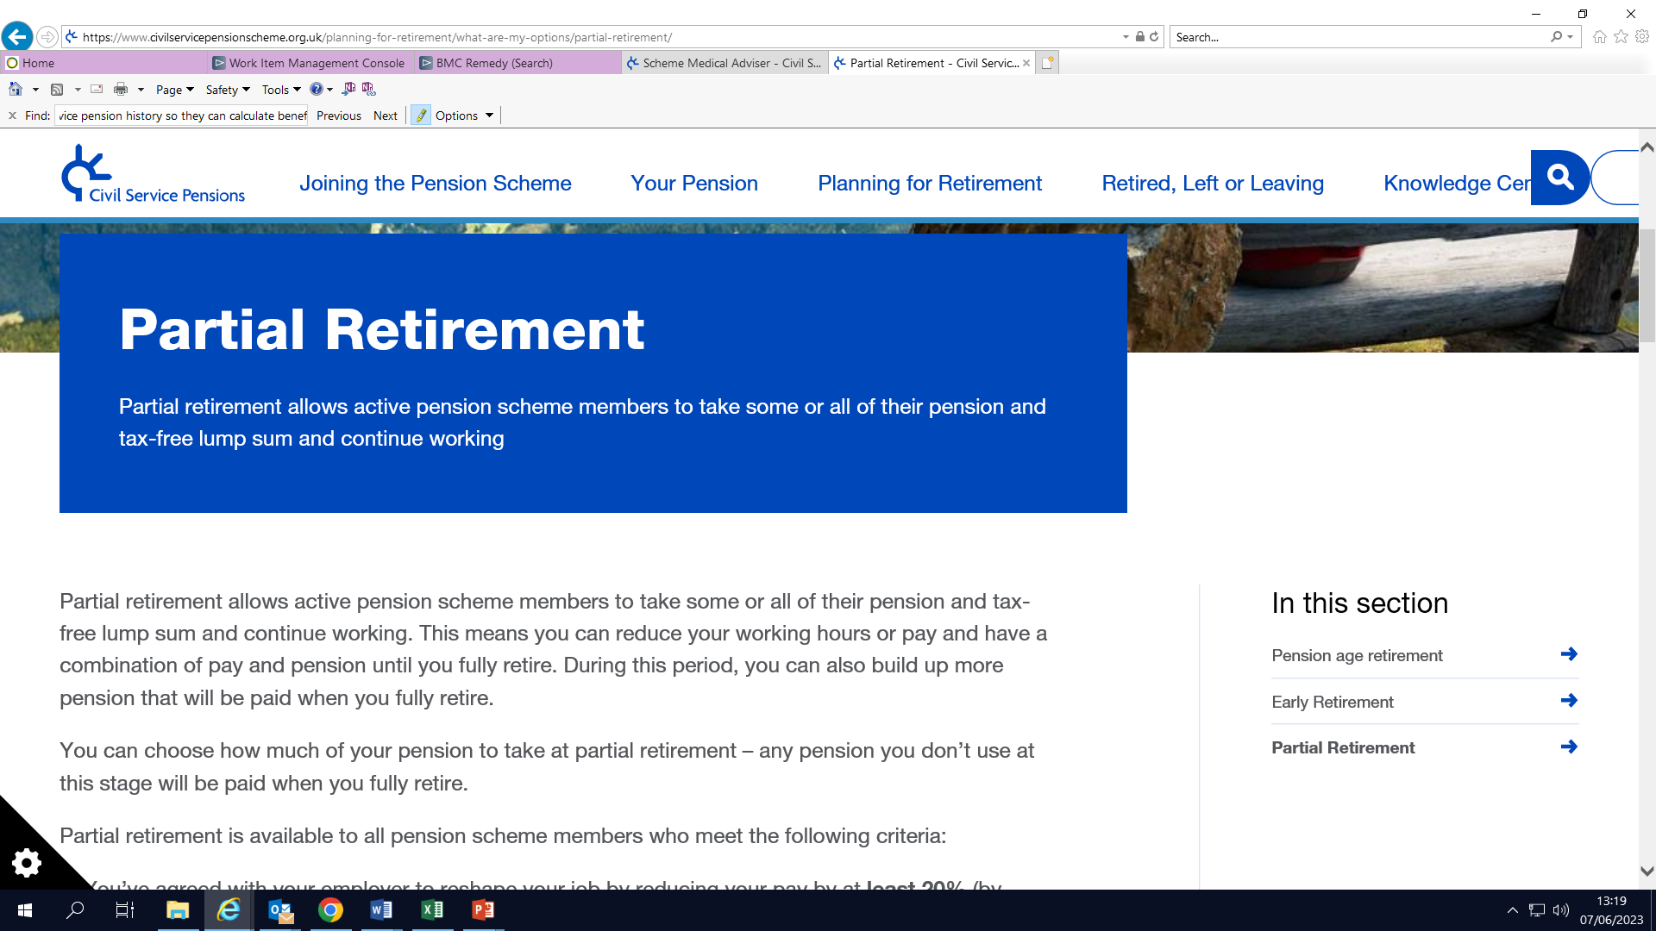
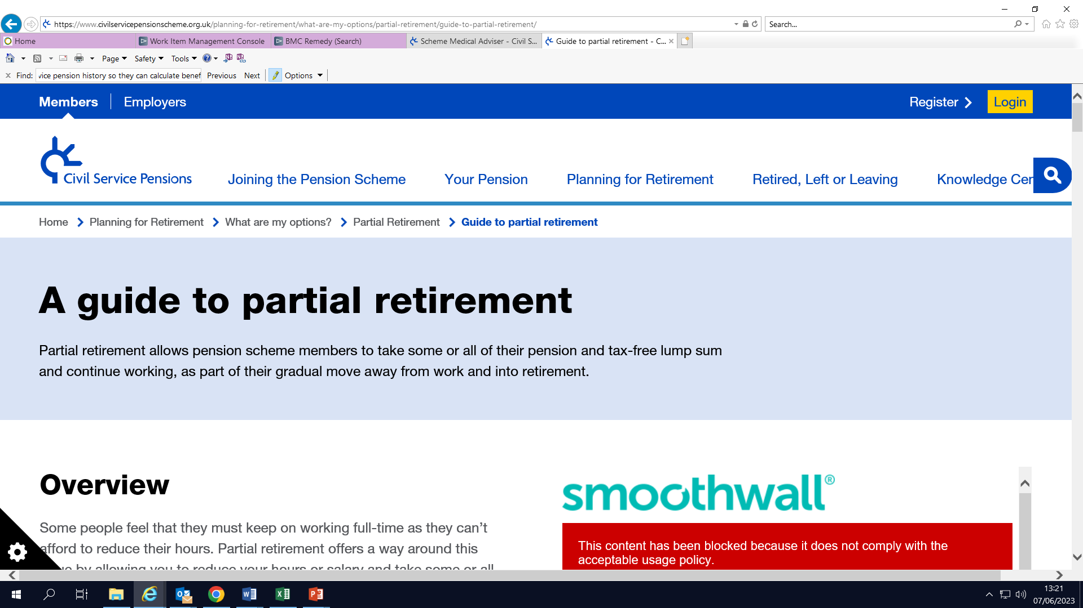
Partial retirement – Where to Start?
Notes:
Starting point for any member before the approach the employer.
Website has a section on partial retirement which advises the member of scheme
Also a further guide to partial retirement which explains the process and steps.

Slide 6
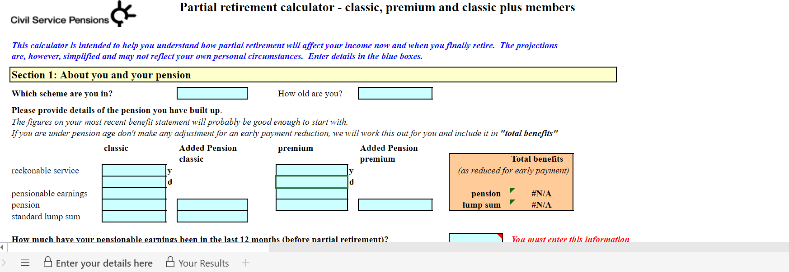
Partial retirement – Calculator
Notes:
One of the key tools that the member needs to use prior to completing the CSP15 is the calculator. This will help them calculate the PR and estimate what this could give them regarding pension/lump sum figures.
The member will need their last ABS to input the key information required on the calculator.
It will also advise the potential impact on the member around abatement.
The reason the calculator only references classic, classic plus and premium is that abatement doesn’t apply to nuvos or alpha scheme.
We would advise the members never to enter into any financial commitments before the PR has been finalised.

Slide 7

Partial retirement
CSP15

Slide 8
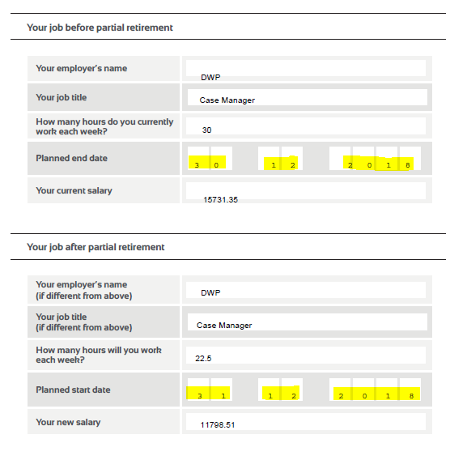
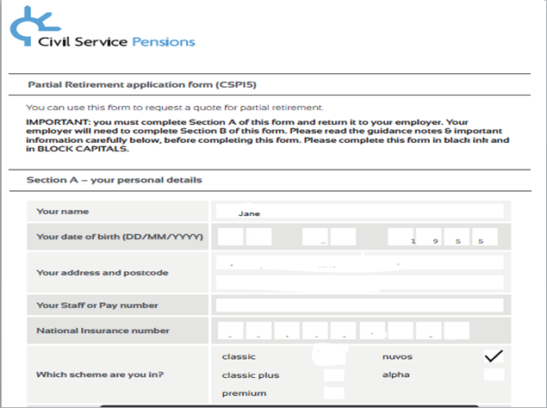
CSP15
Notes:
Section A – To be completed by the member
This includes personal details and details of your role before partial retirement and after partial retirement.

Slide 9
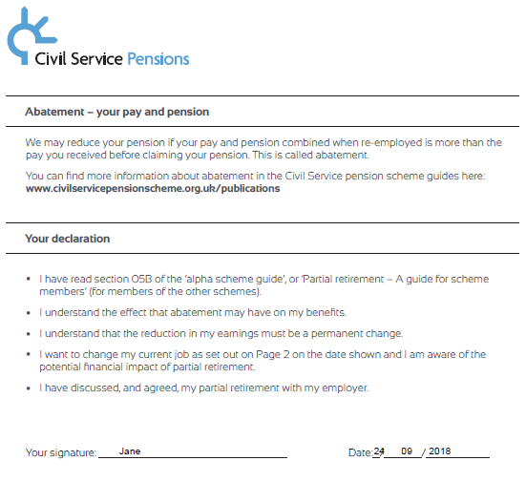
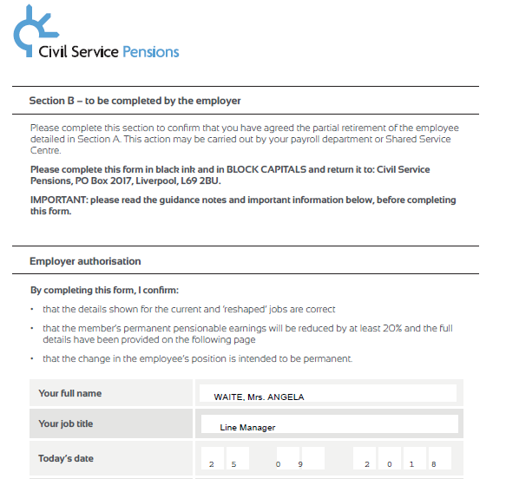
CSP15
Notes:
At the end of section A it provides details of abatement and a link to the abatement guide.
A declaration that the member signs were they advise that the had read the PR guide on the website, understand the impact of abatement, understand it is a permanent change, confirm they want to make the change and the financial impact of PR and finally that they have agreed the change with their employer.
Section B is the employer section
Details of the employer authorisation

Slide 10
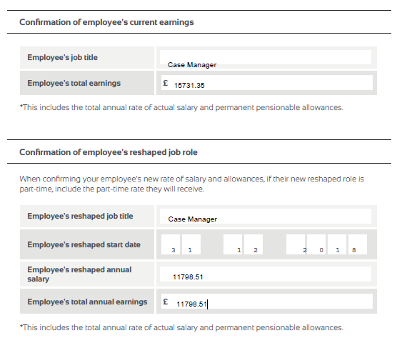
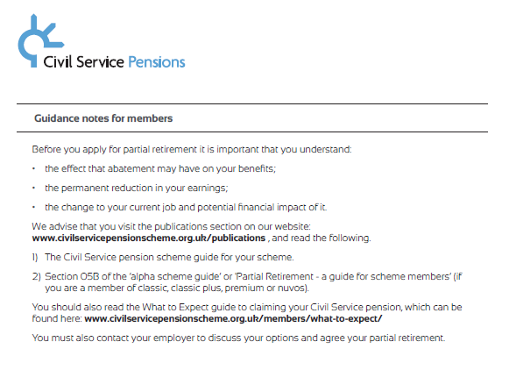
CSP15
Notes:
Confirmation of current earnings
Confirmation of reshaped earnings
There is also guidance notes for both members and employers to help both parties understand what they need to do.
Once the employer completes their section they can then send the CSP15 to MyCSP to begin the process. Ideally with four months notice.

Slide 11
Partial retirement
Scheme Administrator Actions

Slide 12

Partial retirement - End to End Process
Member speaks with employer to see if partial is possible
If agreed, member fills out their portion of CSP15 and passes to employer
Employer checks CSP15, completes, signs & forwards to MyCSP
Member decides how much pension and lump sum to take
MyCSP produces a quote for the member
MyCSP carry out Data Validation in accordance with rules of Partial Retirement
Member returns their Personal Details Form (PDF)
MyCSP calculate and apply any abatement & pay the award
Version 2.1 Effective Date: September 2021 Owner: Training Team Review : September 2023
12
Notes:
4 months before retirement:
Member requests retirement
Employer sends completed RFS/CSP15 form to scheme administrator
NIGO CHECK
- On form
Data Validation Check
On interface record – This will be where DR1’s are produced.
Members continue to accrue benefits in the same pension scheme, just at a slower rate.
Final salary members accrue reckonable service at a pro rata rate and the full time equivalent pensionable earnings are used.
Career average members accrue pension as a percentage of their reduced earnings.
Members with a tapered enrolment date to alpha will still move over when their tapered date comes.

Slide 13
NIGO checks
NIGO stands for Not In Good Order.
This is an internal process to MyCSP to ensure that applications and forms include everything we require to process.
If the application form is not completed correctly this will be returned at first point of contact and may cause delays.
Notes:
We have specific pension administrators in our enquiry centre who complete these NIGO checks, normally within a few days of the request being sent to us. If we do return something as ‘not in good order’ the case is closed and will not be re opened until we receive the completed request back.

Slide 14
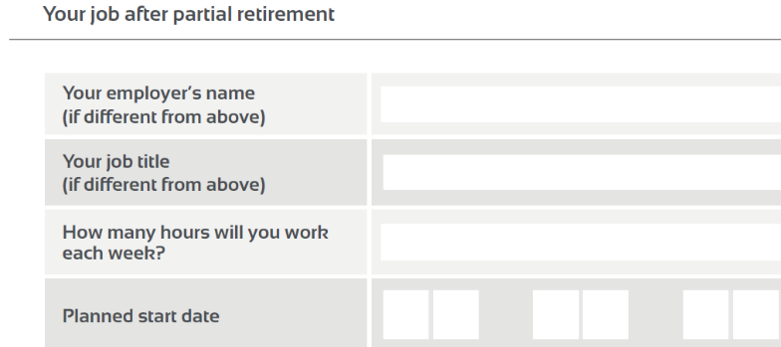
Common NIGO fails – CSP15
The most common error is that the start date of the employees new role is not the day after the end date for their current role.
Notes:
These dates must be consecutive. If a members current role ends on a Friday and the new one starts on the Monday, the end date must be the Sunday.
- As sourced from our enquiry centre staff.

Slide 15
classic and classic plus members
who are due a WPS refund
If the member is dual and is taking all benefits from the PCSPS section, they may have their refund paid at partial.
For example:
Mr Bloggs is a classic/alpha dual member and has always been single.
He is retiring on 31 December with all of his classic benefits plus 50% of his alpha pension.
Because he is taking all of his classic pension, he can have his refund at partial.
Notes:
The WPS refund would not be included on the quote as we do not know what the member has chosen options-wise at this point.
Members continue to accrue benefits in the same pension scheme, just at a slower rate.
Final salary members accrue reckonable service at a pro rata rate and the full time equivalent pensionable earnings are used.
Career average members accrue pension as a percentage of their reduced earnings.
Members with a tapered enrolment date to alpha will still move over when their tapered date comes.

Slide 16
Abatement

Slide 17
Abatement
The members new total earnings cannot exceed what they were earning before claiming their pension (salary of reference).
Pension
New salary
Total earnings
If it does, the difference is deducted from their pension payments.
Notes:
The pension the member claims plus their new salary cannot exceed what their pensionable earnings were normally in the 12 months prior to partial retirement date. This can differ slightly from scheme to scheme and can be checked in the scheme rules on our website.
The difference is deducted from their pension payments and is removed/adjusted as civil service employment changes.
Members do not get a back payment of anything previously abated.

Slide 18
Salary of reference
classic
premium
Your pensionable earnings in your last 12 months, or
Your highest pensionable earnings in one of the last 2 complete scheme years
classic plus
Your pensionable earnings in your last 12 months, or
nuvos
Your actual pensionable pay in your last 12 months
The actual pensionable earnings figure used to calculate your pension benefits
Your highest pensionable earnings in one of the last 2 complete scheme years
Notes:
The specific period that we use as the ‘salary of reference’ for abatement purposes differs from scheme to scheme.

Slide 19
Abatement factor
As the premium, classic plus and nuvos schemes don’t offer an automatic lump sum like classic, we apply an abatement factor of 0.8125 to the members annual pension when calculating abatement.
This rule is to ensure that abatement is applied fairly across all schemes.

Slide 20
Abatement
Does not apply to alpha
Does not apply to members over 75
Not affected by overtime
/inflation
Pre commutation figures used
Removed/
Adjusted if service changes
Notes:
Abatement doesn’t apply to the alpha pension scheme or to members over age 75.
Standard inflationary increases to salary or salary of reference do not effect it and neither does overtime.
We use the annual pension figure before the member has commuted anything for a lump sum, therefore a member claiming a higher lump sum will not change the abatement calculation. Members can choose not to claim 100% of the benefits they have accrued. Whatever they don’t claim with be stored for full retirement (final salary = reckonable service & career average = pension amount).

Slide 21
CSP13
Following Partial Retirement, if a member’s earnings change, this can affect the amount of pension being paid to them.
For example, if there may be a promotion and a higher salary, we may need to increase the abatement of their pension
The employer would then need to complete a CSP 13 form and send it directly to MyCSP.
The level of abatement will not be affected by normal annual pay rises or by overtime.
Notes:
CSP13 is for any changes to the members earnings.
The employer is responsible for updating MyCSP.
Further details for when a CSP13 is required can be found in the EPG – Section 4.3. - Your responsibilities when re-employing pensioners and form CSP13

Slide 22
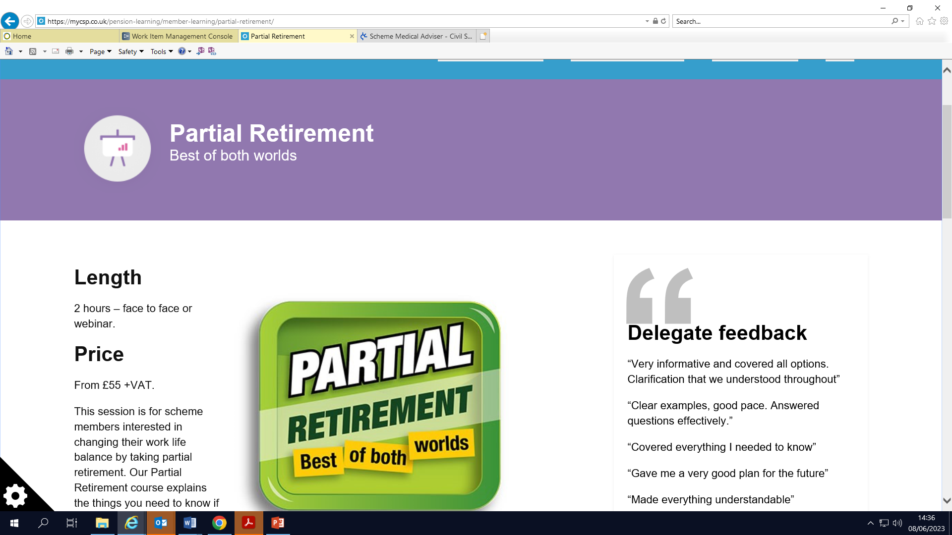
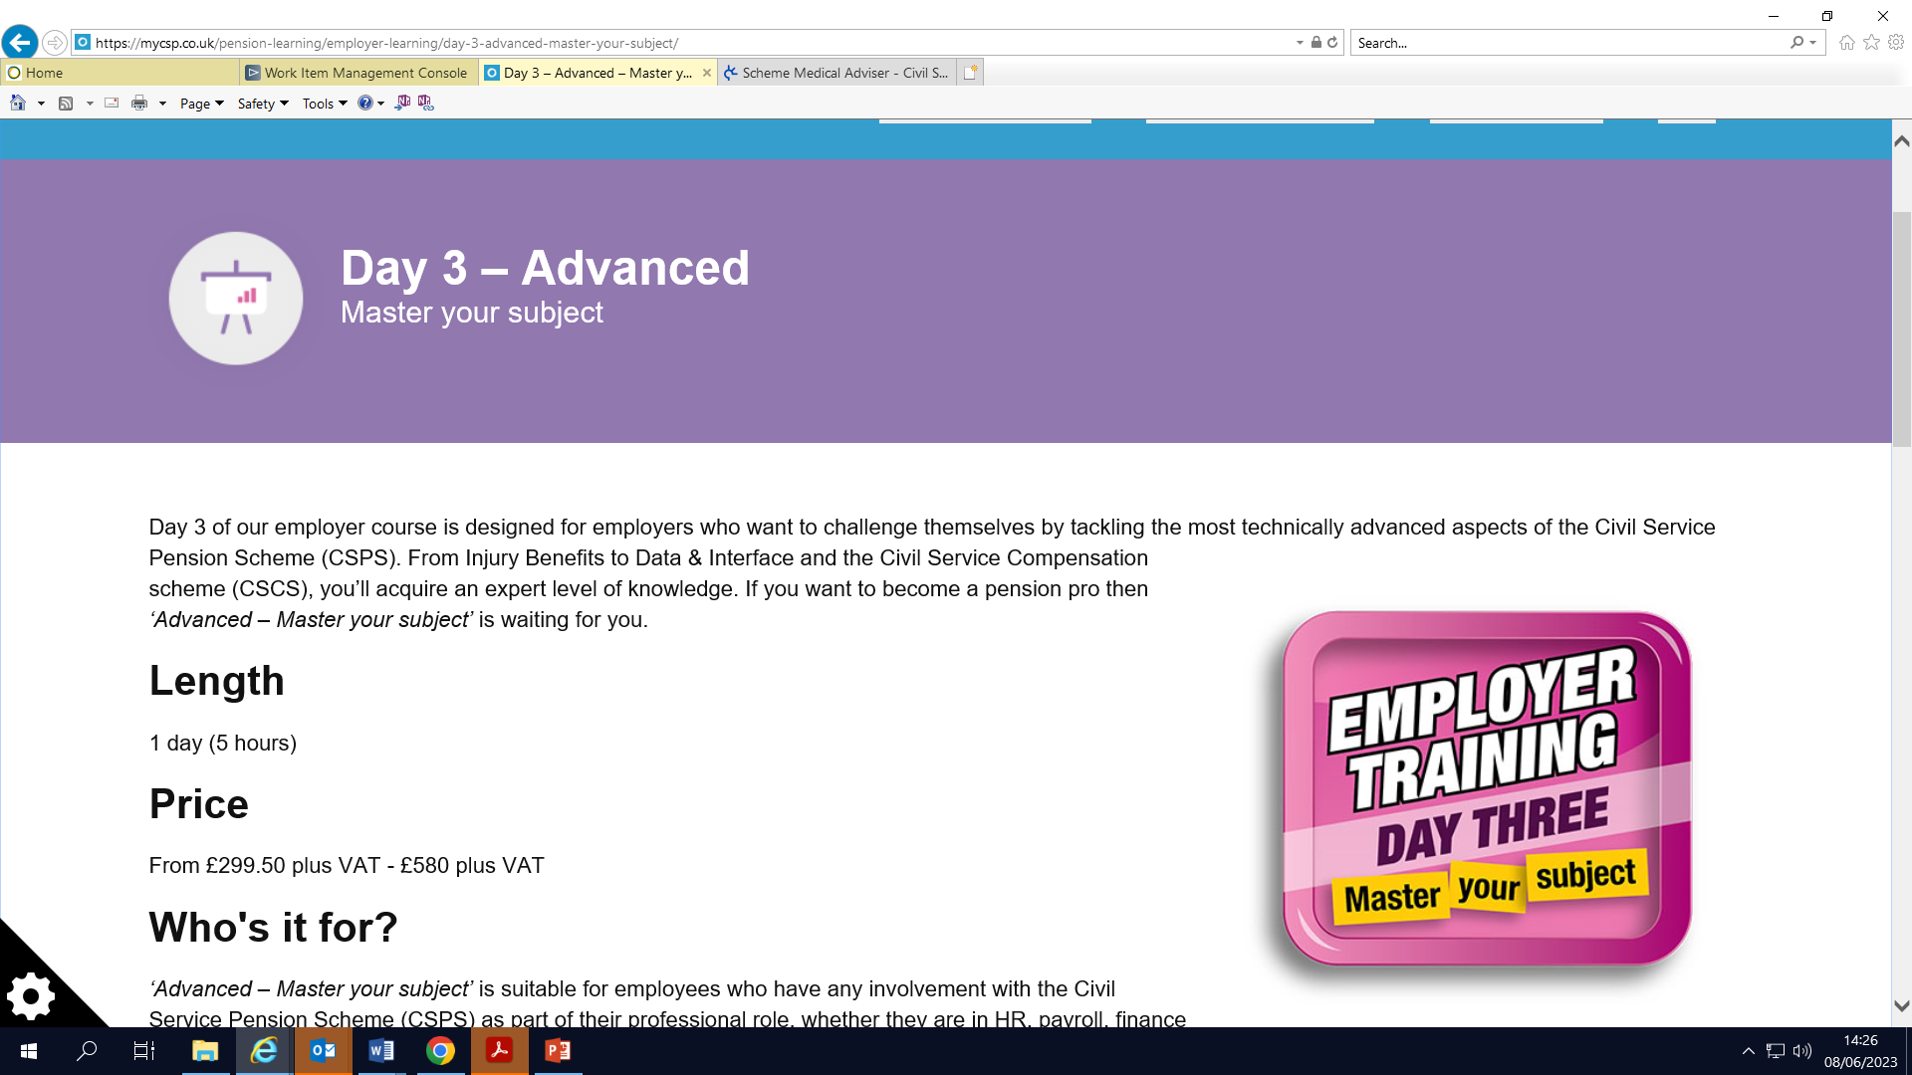
Further Support
Member Support
Day 1, 2 and 3 Employer Support
Notes:
Member Support
Partial Retirement Course – 2 hours face to face or webinar. Open courses available now.
Employer Courses – 1 day courses each
Day 1 Introduction – Know your basics
Day 2 Intermediate – Expand your knowledge
Day 3 Advanced – Master your subject

Slide 23
Hot Topics – What's coming up for Employers?
Remedy Data Collection Part 3
Track my Case Pilot
Hot Topics – Autumn Edition
Regional Employer Forum’s
Remedy – Dual Quotes
Civil Service Pensions Podcast
Employer Insight Survey
Annual Benefit Statement MI Reconciliation
Pension Saving Statements – Member Support
Pensions Awareness Month
Notes:
Remedy Data Collection Part 3 – It was mentioned in the last REF that a further data collection would be required to sweep up the outstanding and any data relating to SoW’s.
Track my Case Pilot – The expansion of TMC has now been moved to 2024 whilst work on the process continues.
Hot Topics – Next session will take place in November
REFs – Expected to take place in w/c 30/10 and w/c 6/11. Placeholder should be out shortly.
Remedy Dual Quotes – EPN690. Reminder that from dual quotes will be provided for anyone with a LDOS of 1/10.
Employer Insight Survey – ‘You said, we did’ will be shared in October and survey planned for November for three weeks.
Podcast – Season 2 is planned to go live early September so keep an eye out fo the EPN
ABS – EPN688. MI will be provided by 8/9 for employers to then reconcile against payroll.
PAM – EPN691. Planned for the whole of September. If you haven’t shared with your members then please do this quickly to give them a chance to access the webinars planned.
PSS Support – EPN688. MI will be provided by 16/9 for to consider how they will support their members. If you need any support then contact your ERM.

Slide 24
Any Questions?

