Slide 1
Regional Employer Forums Autumn 2023
Liverpool 30 October
Edinburgh 2 November
Cardiff 7 November
London 9 November

Slide 2
Civil Service Pensions On Your Radar

Slide 3
Valuation 2020 and Member contributions
2020 Valuation completed and report published 2 October.
No Cost control mechanism breach.
Because of this the Minister doesn’t need to consult on changes to the scheme.
Lower salary threshold will be increased in line with CPI from April 2024.
Member contribution rates remain unchanged.
www.civilservicepensionscheme.org.uk

Slide 4
Valuation 2020 and Employer contributions
New flat-rate Employer contribution rate of 28.97%.
This will cover between 1 April 2024 – 31 March 2027.
No impact on member pension benefits.
Departments should contact their HM Treasury spending contact
New Fair Deal employers should contact their contracting authority.
See EPN 698.
www.civilservicepensionscheme.org.uk

Slide 5
Changes to the Civil Service Compensation Scheme
Government remains committed to reforming the Compensation scheme
Changes aren't expected in the immediate future.
Committed to providing at least 3 months notice before any new scheme terms come in.
www.civilservicepensionscheme.org.uk

Slide 6
Annual Allowance - a reminder
2015 Remedy “Rollback” means Pensions Input amounts will be incorrect.
HMRC have agreed that Pension Savings Statement will not be issued for members impacted.
A letter will be issued advising members who would have likely breached and regularly receive.
By 6 October 2024, Pension Input Amounts will be recalculated and a special Pension Savings Statement, including for 2022/23, will be issued.
www.civilservicepensionscheme.org.uk

Slide 7
Classic survivor benefits (Walker & Goodwin judgments)
We continue to consult with the unions & CSPA about the equalisation of adult survivor benefits under classic and classic plus, subject to the necessary member contributions having been paid to, and retained by, the scheme.
We expect to make the changes in early 2024.
www.civilservicepensionscheme.org.uk

Slide 8
Pension Dashboard
Regulations in August 2023 removed the statutory staging deadlines and replaced them with a single connection deadline of 31 October 2026.
DWP will publish the staging timeline in guidance, setting expectations of when schemes will connect ahead of the deadline.
We’ll update you once we understand what the changes mean for Civil Service Pensions.
www.civilservicepensionscheme.org.uk

Slide 9
Bubbling under
Factors
Actuarial factors are used by the scheme to calculate everything from the cost of buying added pension to the amount of pension a transfer in will buy.
GAD has now provided all the new actuarial factors needed and MyCSP are in the process of implementation. All factors will be implemented by 1 April 2024.
Extension of Auto-Enrolment
The Pensions (Extension of Automatic Enrolment) Act 2023 gained Royal Assent on 19 September this year. No significant changes expected to how we enrol members but will consider the implementing regulations once they are drafted.
www.civilservicepensionscheme.org.uk

Slide 10
Bubbling under
Lifetime Allowance (LTA)
HMRC have consulted on regulations to abolish the LTA from April 2024.
HMRC has confirmed they plan to retain the 25% maximum tax-free cash limit on Pension Lump Sums.
www.civilservicepensionscheme.org.uk

Slide 11
2015 Remedy Programme (McCloud)

Slide 12
Programme update: Data/Data Collection
Phase 1 successfully returned 260K data items. This completed in August 2022 with 95% of the required data collected.
Phase 2 ended with over 136K members data received and over 610K data items received.
Phase 3 completed on 31 August in readiness for Rollback on 1 October.
The programme has provided circa £500k financial support to employers to assist with data collection impacts.
www.civilservicepensionscheme.org.uk

Slide 13
Programme update: Ill health
Tranches 1 and 2 complete (for the period 1 July 2017 - 31 March 2022)
Tranche 3 in progress - c.1,370 Health Assured awarded members:
(for the period 1 April 2015 - 30 June 2017)
Employers who have completed retrieval have located 78% of the outcome reports for these members
Members have been contacted for consent for the outcome report to be shared with MyCSP and consent for reassessment
Around 29% of members have returned the consent form
We are working with a few employers to test the end to end process
www.civilservicepensionscheme.org.uk

Slide 14
Programme update: Remediable Service Statements
Remediable service statements for the immediate choice (retired) members will be made up of:
Cover letter;
Choice illustration;
Supporting information;
Choice form – choice can be returned by post or made digitally.
These will start to be issued from Spring 2024. All RSSs must be issued by April 2025
Work continues developing the digital portal for recording the members choice.
Member testing has been taking place on transitional quotes.
www.civilservicepensionscheme.org.uk

Slide 15
Programme update: Deferred Choice Underpin (DCU) quotes
Quotation statistics
DCU dual quotes started to be issued from the beginning of August 23.
As at 5 October 2023, a total of 2,643 DCU quotes have been issued.
1,248 of these have been returned
64% of members choosing Option A (Legacy)
36% opting for Option B (Reform).
www.civilservicepensionscheme.org.uk

Slide 16
Programme update: Deferred Choice Underpin quotes
Improving the member experience
Work has started on interviewing members and gathering iterative feedback on the quotation packs.
We are assessing the MI from the call centre, looking at: queries, complaints and feedback.
We would like your employer feedback.
We have asked Unions, Civil Service Pensioners Alliance (CSPA) and Money and Pension Advice Service (MAPS) for feedback.
This work will feed in to the supporting tools: videos, web pages etc.
www.civilservicepensionscheme.org.uk

Slide 17
Scheme consultation and legislation
The public consultation concluded in August 2023 with the publication of the consultation outcome report. Link https://www.gov.uk/government/consultations/civil-service-pension-scheme-2015-remedy-mccloud-regulations
No material challenges to the draft regulations.
Further regulation concerning club transfer, however only impacts a small number of members wishing to retire soon after 1 October 2023.
The scheme regulations to bring into force the 2015 remedy effective from 1 October 2023 were laid in parliament on 6 September. https://www.legislation.gov.uk/uksi/2023/942/contents/made
www.civilservicepensionscheme.org.uk

Slide 18
What’s new
Case studies
Partial retirement information
Remedy roundup
Timeline
www.civilservicepensionscheme.org.uk

Slide 19
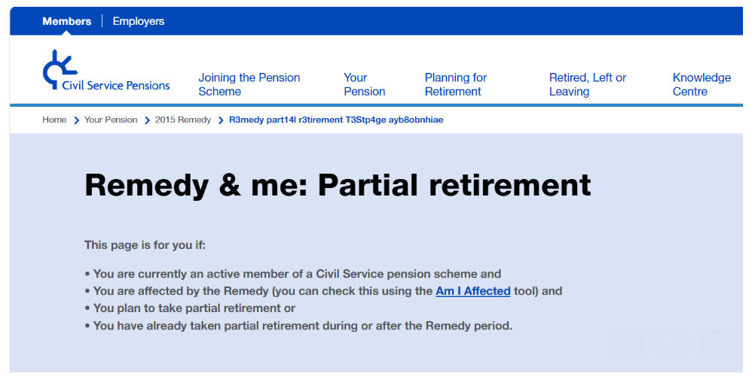
What’s new - Case Studies and Partial Retirement
Partial Retirement webpage
Partial retirement case studies
Support
www.civilservicepensionscheme.org.uk

Slide 20
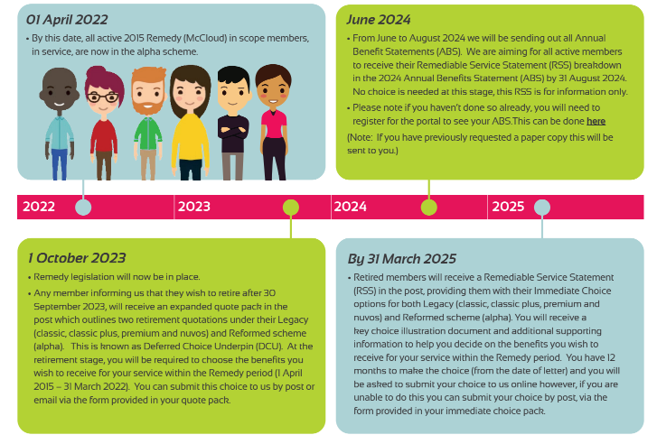
2015 Remedy (McCloud) timeline
www.civilservicepensionscheme.org.uk

Slide 21
Help to spread the Remedy word
Continue to encourage your employees to take action:
Check if they are affected by 2015 Remedy via the “Am I affected tool”: https://retirementmodeller.civilservicepensionscheme.org.uk/remedy
Obtain an illustration of how they might be affected financially for the remedy period via the Remedy Benefits Illustrator: https://remedy-illustrator-7year www.civilservicepensionscheme.org.uk/
Engage with 2015 Remedy Linkedin posts Search; #civilservice, #2015remedy, #mccloud Help and Guidance is always on hand;
FAQs • Chatbot • Remedy Updates Page.
www.civilservicepensionscheme.org.uk

Slide 22
Employers’ support
Visit the employer hub: https://www.civilservicepensionscheme.org.uk/employers/
This now holds all employer communications on this site so you can access as and when required.
We are always on hand for any 2015 Remedy queries Email us: employerremedyqueries@mycsp.co.uk
Keep feeding back to us – How are we doing? What can we improve?
www.civilservicepensionscheme.org.uk
Got a Question? www.slido.com #2448121

Slide 23
Engagement update

Slide 24
Pension Awareness Month
Ran across September
13 Live Streams
Over 28,000 attendees
Themed Website content each week
5,200 completed Post Event Survey
95% said event helped them better understand their pension
98% would recommend to a colleague
www.civilservicepensionscheme.org.uk

Slide 25
Podcast – Season 2
42,354 total Downloads for both seasons
Season two consists of:
6 full episodes & 6 Mini-sodes
Release Timeline
August 2023 – November 2023
www.civilservicepensionscheme.org.uk

Slide 26
Portal updates
Total of 523.4k members registered
354.5k Active (61.2% of population)
147.5k Pensioner (20.3% of population)
21.4k Deferred (5.9% of population)
122k App downloads
Future plans
Enhancement of Retirement Modeller
Deferred portal and current value statement
www.civilservicepensionscheme.org.uk

Slide 27
Opt Out Campaign
4,699 letters issued
747 member viewed dedicated webpage
141 member re-joined the scheme
59 joined Partnership
477 chose to stay opted out
www.civilservicepensionscheme.org.uk

Slide 28
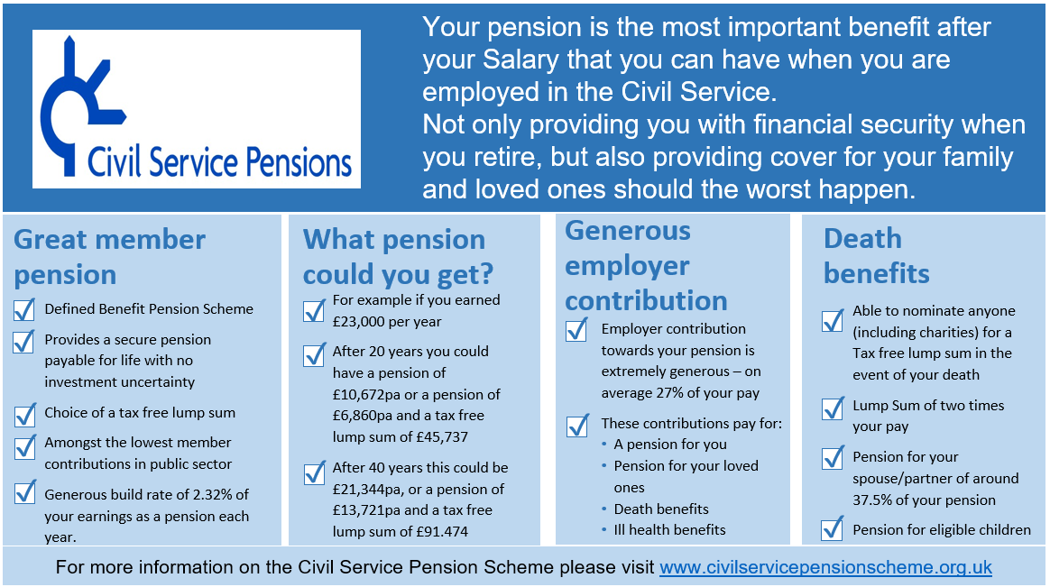
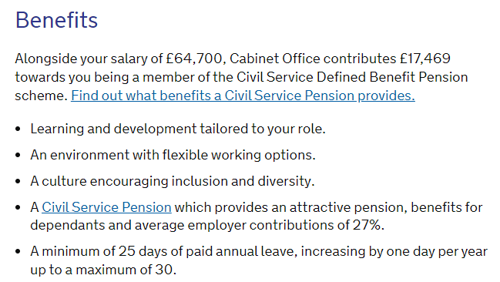
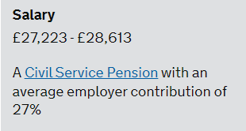
Recruitment & Retention
Candidate Pack slide.
Job advert amendments.
DB vs DC Comparison.
www.civilservicepensionscheme.org.uk

